Slide 1
Study Buddy
Prepared by:
Jaskaran Singh & Brendan Spranger

Slide 2
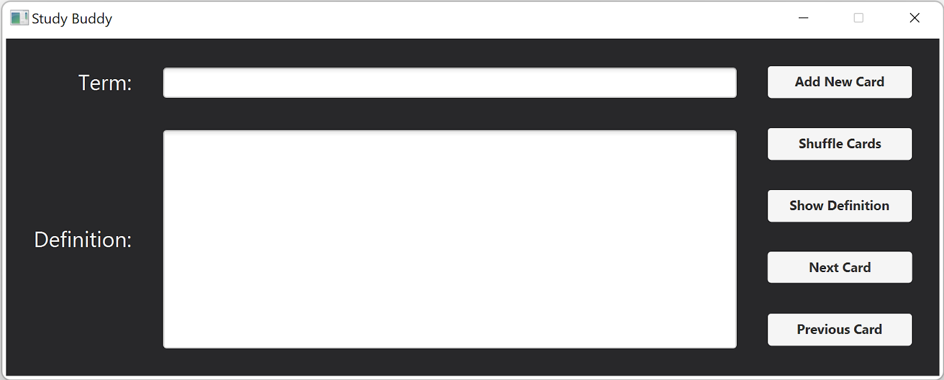
What is it?
Study Buddy is a flash card application designed to help students study key terms and their definitions.

Slide 3


Why use Study Buddy?
Study more efficiently
Get higher grades
Bring Study Buddy anywhere
Save money on school supplies
Reduce your environmental impact

Slide 4
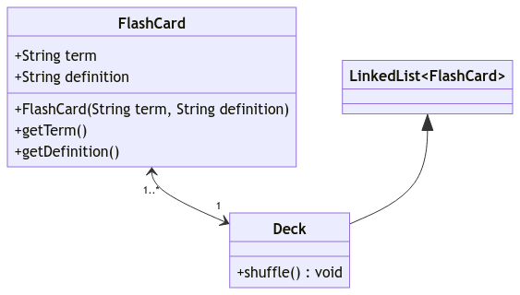
How it Works
Created two classes
FlashCard
Deck (extends LinkedList)

Slide 5
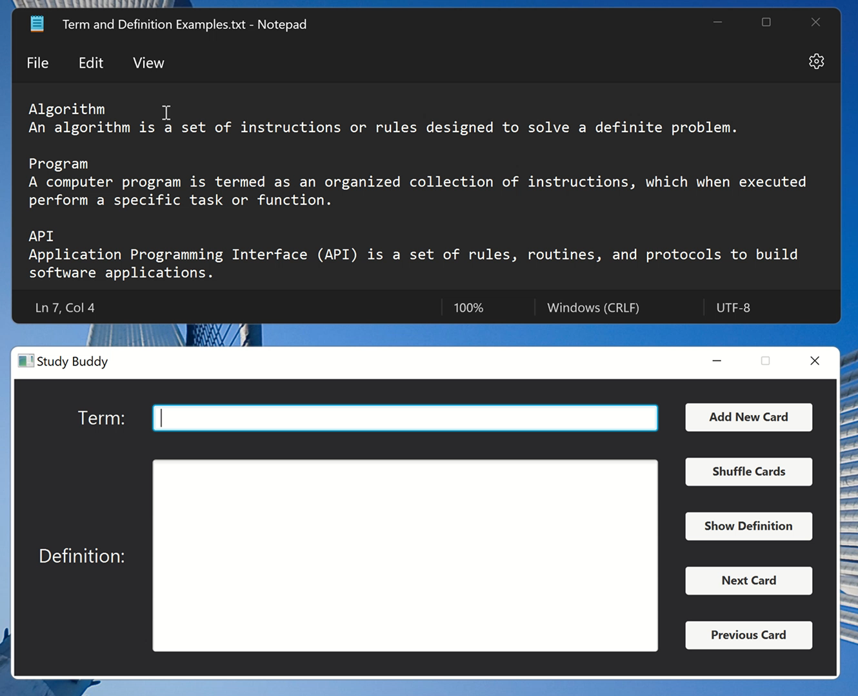
Adding Flash Cards

Slide 6
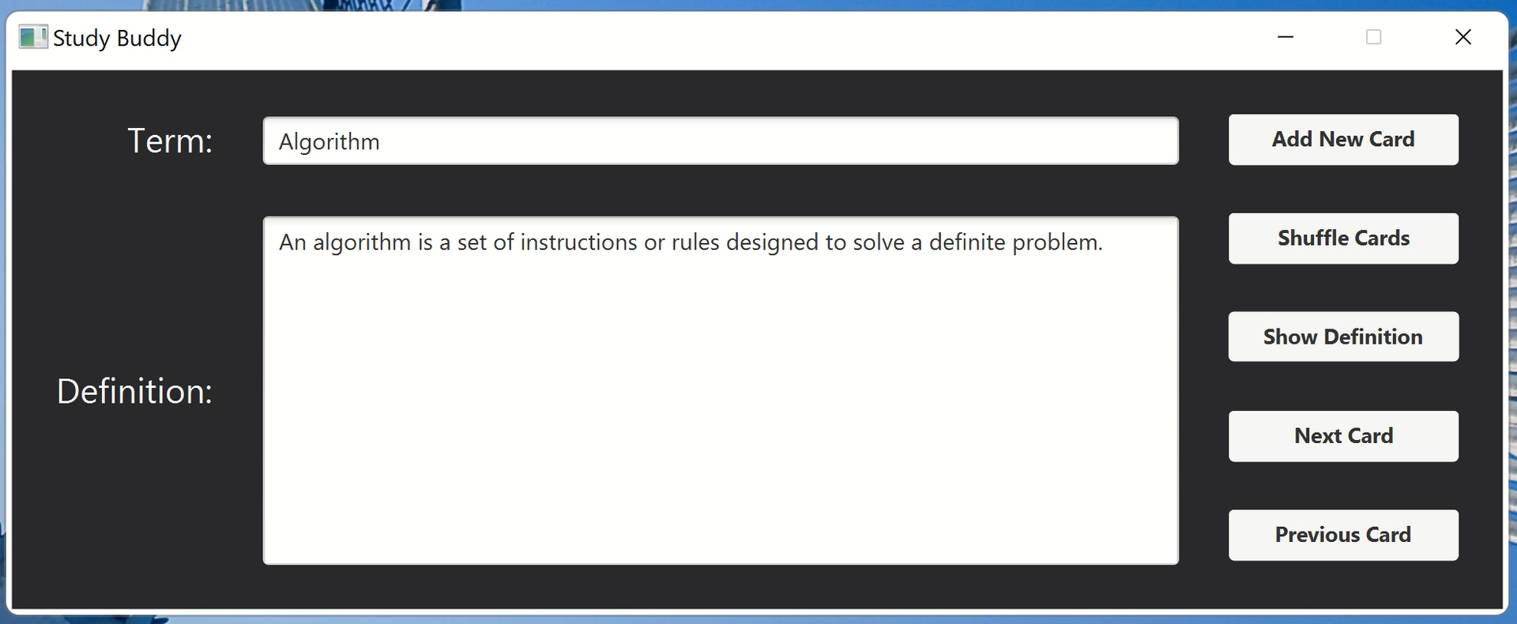
Shuffling flash cards

Slide 7
Thank you for your time
Any Questions?

